Slide 1
Unit-5 Network Forensics
Dr. Vijeta Khare

Slide 2
Footprints: refer to the impact that an investigator has on the systems under examination
When conducting network forensics, investigators often work with live systems that cannot be taken offline.
These may include routers, switches, and other types of network devices, as well as critical servers.
network-based evidence is often highly volatile and must be collected through active means that inherently modify the system hosting the evidence.
Even when investigators are able to sniff traffic using port monitoring or tapping a cable, there is always some impact on the environment, however small.
This Every interaction that an investigator has with a live system modifies it in some way,

Slide 3
Concepts in Digital Evidence
evidence (noun)
1. information or signs indicating whether a belief or proposition is true or valid.
2. information used to establish facts in a legal investigation or admissible as testimony in a law court.
• Real
• Best
• Direct
• Circumstantial
• Hearsay
• Business Records
• Digital
• Network-Based Digital

Slide 4
Real Evidence
Real evidence usually comprises the physicality of the event, and as such is often the most easily presented and understood element of a crime.
Examples of “real evidence” can include:
• The murder weapon
• The fingerprint or footprint
• The signed paper contract
• The physical hard drive or USB device
• The computer itself—chassis, keyboard, and all

Slide 5
Best Evidence
“Best evidence” is roughly defined as the best evidence that can be produced in court.
To prove the content of a writing, recording, or photograph, the original writing, recording, or photograph is required
Examples of “best evidence” include:
• A photo of the crime scene
• A copy of the signed contract
• A file recovered from the hard drive
• A bit-for-bit snapshot of a network transaction

Slide 6
Direct Evidence
“Direct evidence” is the testimony offered by a direct witness of the act or acts in question
Direct evidence is usually admissible, so long as it’s relevant. What other people witnessed can have a great impact on a case.
Examples of “direct evidence” can include:
“I watched him crack passwords using John the Ripper and a password file he shouldn’t have.”
“I saw him with that USB device.”

Slide 7
Circumstantial Evidence
In contrast to “direct evidence,” “circumstantial evidence” is evidence that does not directly support a specific conclusion. Rather, circumstantial evidence may be linked together with other evidence and used to deduce a conclusion.
the primary mechanism used to link electronic evidence and its creator.”7 Often, circumstantial evidence is used to establish the author of emails, chat logs, or other digital evidence.
In turn, authorship verification is necessary to establish authenticity, which is required for evidence to be admissible in court
Examples of “circumstantial evidence” can include:
• An email signature
• A file containing password hashes on the defendant’s computer
• The serial number of the USB device

Slide 8
Hearsay
“Hearsay” is the label given to testimony offered second-hand by someone who was not a direct witness of the act or acts in question
Digital evidence can be classified as hearsay if it contains assertions created by people.
Examples of “hearsay” can include
“The guy told me he did it.”
• “He said he knew who did it, and could testify.”
• “I saw a recording of the whole thing go down.”
• A text file containing a personal letter

Slide 9
Business Records
Business records can include any documentation that an enterprise routinely generates and retains as a result of normal business processes, and that is deemed accurate enough to be used as a basis for managerial decisions
Examples of “business records” can include:
Contracts and other employment agreements
Invoices and records of payment received
Routinely kept access logs
/var/log/messages

Slide 10
Digital Evidence
“Digital evidence” is any documentation that satisfies the requirements of “evidence” in a proceeding, but that exists in electronic digital form.
Examples of “digital evidence” include:
• Emails and IM sessions
• Invoices and records of payment received
• Routinely kept access logs
• /var/log/messages

Slide 11
Network-Based Digital Evidence
“Network-based digital evidence” is digital evidence that is produced as a result of communications over a network.
The primary and secondary storage media of computers (e.g., the RAM and hard drives) tend to be fruitful fodder for forensic analysis.
Examples of “network-based digital evidence” can include:
• Emails and IM sessions
• Browser activity, including web-based email
• Routinely kept packet logs
• /var/log/messages

Slide 12
Challenges Relating to Network Evidence
• Acquisition: It can be difficult to locate specific evidence in a network environment.
• Content : metadata, network devices may or may not store evidence, due to limited storage capacity.
• Storage: Network devices commonly do not employ secondary or persistent storage.
• Privacy: Depending on jurisdiction, there may be legal issues involving personal privacy that are unique to network-based acquisition techniques.
• Seizure: Seizing a network device can be much more disruptive. In the most extreme cases, an entire network segment may be brought down indefinitely.
• Admissibility: Network forensics is a newer approach to digital investigations. There are sometimes conflicting or even nonexisting legal precedents for admission of various types of network-based digital evidence

Slide 13
Network Forensics Investigative Methodology (OSCAR)
• Obtain information
• Strategize
• Collect evidence
• Analyze
• Report

Slide 14
Obtain Information
The Incident
• Description of what happened, • Date, time, and method of incident discovery, • Persons involved, • Systems and data involved, • Actions taken since discovery, • Summary of internal discussions, • Incident manager and process, • Legal issues, • Time frame for investigation/recovery/resolution, • Goals
The Environment
Business model, • Legal issues, • Network topology (request a network map, etc. if you do not have one), • Available sources of network evidence, • Organizational structure,• Incident response management process/procedures • Communications systems • Resources available

Slide 15
Strategize
Here are some tips for developing an investigative strategy:
• Understand the goals and time frame of the investigation.
• List your resources, including personnel, time, and equipment.
• Identify likely sources of evidence.
• For each source of evidence, estimate the value and cost of obtaining it.
• Prioritize your evidence acquisition.
• Plan the initial acquisition/analysis.
• Decide upon method and times of regular communication/updates.
• Keep in mind that after conducting your initial analysis, you may decide to go back and acquire more evidence. Forensics is an iterative process.

Slide 16
Collect Evidence
There are three components you must address every time you acquire evidence:
Document—Make sure to keep a careful log of all systems accessed and all actions taken during evidence collection
Capture—Capture the evidence itself. This may involve capturing packets and writing them to a hard drive, copying logs to hard drive or CD, or imaging hard drives of web proxies or logging servers.
Store/Transport—Ensure that the evidence is stored securely and maintain the chain of custody. Keep an accurate, signed, verifiable log of the person who have accessed or possessed the evidence.

Slide 17
Best practices for evidence collection include:
• Acquire as soon as possible, and lawfully
• Make cryptographically verifiable copies
• Sequester the originals under restricted custody and access (or your earliest copy, when
the originals are not available)
• Analyze only the copies
• Use tools that are reputable and reliable
• Document everything you do!

Slide 18
Analyze
Correlation: between data, timestamps and source
Timeline: timeline of whole activity
Events of Interest: :Isolate events of great interest
Corroboration: False positives verification
Recovery of additional evidence
Interpretation

Slide 19
Report
The report that you produce must be:
• Understandable by nontechnical laypeople, such as:
– Legal teams
– Managers
– Human Resources personnel
– Judges
– Juries
• Defensible in detail
• Factual

Slide 20
Evidence Acquisition

Slide 21
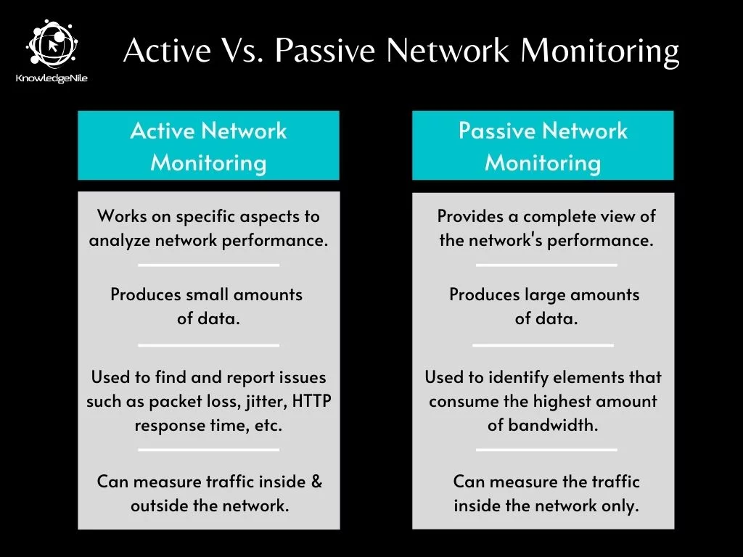
Passive evidence acquisition is the practice of gathering forensic-quality evidence from networks without emitting data at Layer 2 and above.
Active or interactive evidence acquisition is the practice of collecting evidence by interacting with stations on the network

Slide 22
Physical Interception
Cables
Copper
Coaxial: In most cases where coax is used, if you can tap the single copper core, you can access the traffic to and from all stations that share the physical medium.
Twisted Pair (TP): If you put a commercial TP network tap inline, it can capture all voltages for all twisted pairs in the cable.
Optical

Slide 23
Inline network tap
is a system that monitors events on a local network.
hardware device, which provides a way to access the data flowing across a computer network
Network TAPs are inserted between network devices, like a switch and router, where they copy the data without compromising network integrity.
Network taps commonly have four ports: two connected inline to facilitate normal traffic, and two sniffing ports, which mirror that traffic (one for each direction).
Insertion of an inline network tap typically causes a brief disruption, since the cable must be separated in order to connect the network tap inline.
Network forensic analysts should keep in mind that every additional break in a cable is a potential point of failure; therefore inline insertion of network taps necessarily increase the risk of network disruption.

Slide 24
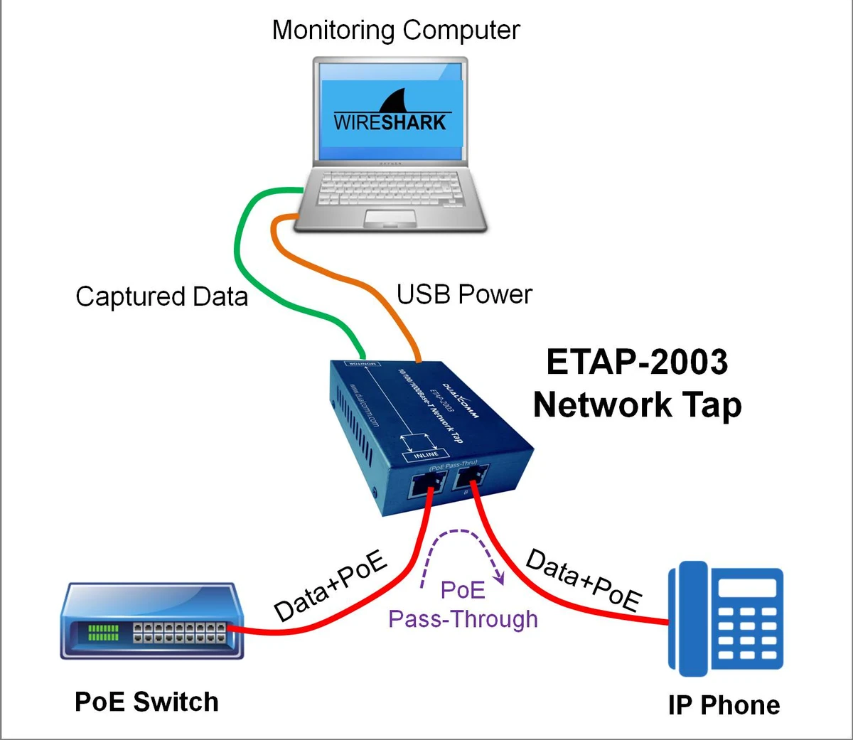
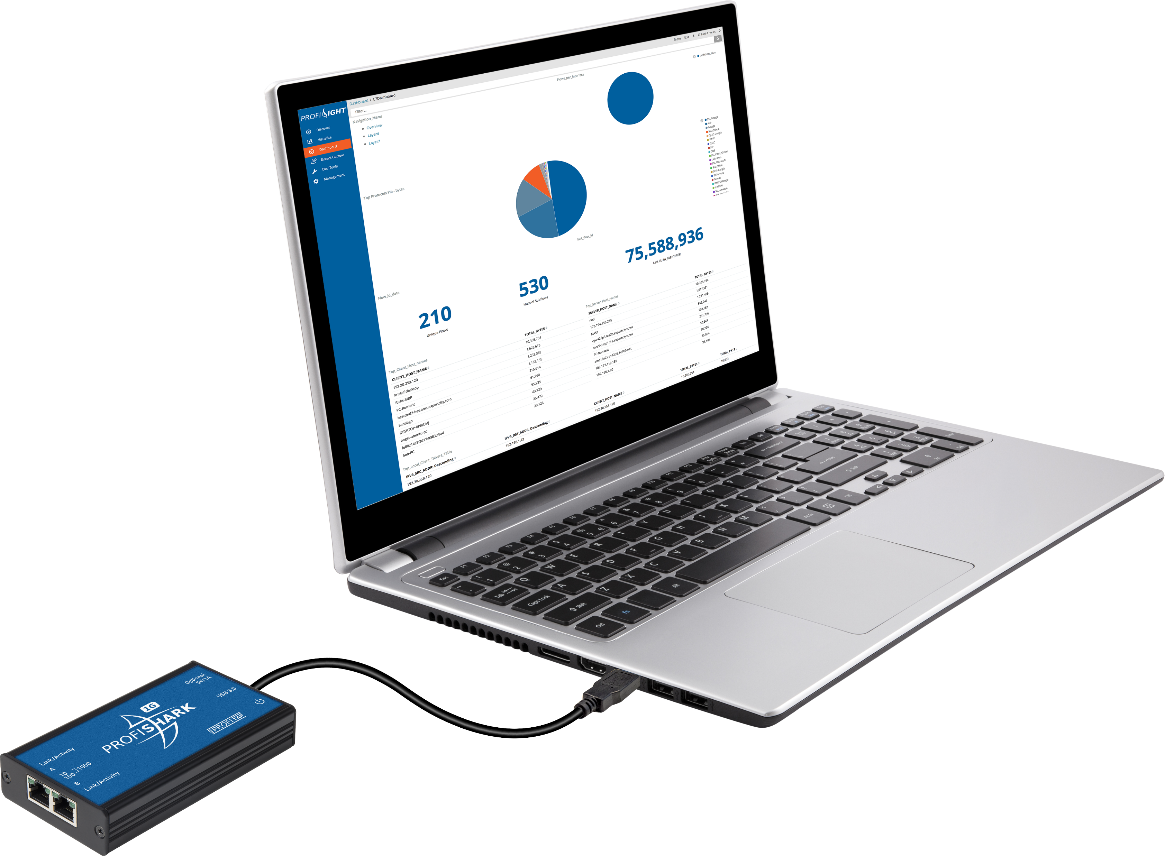
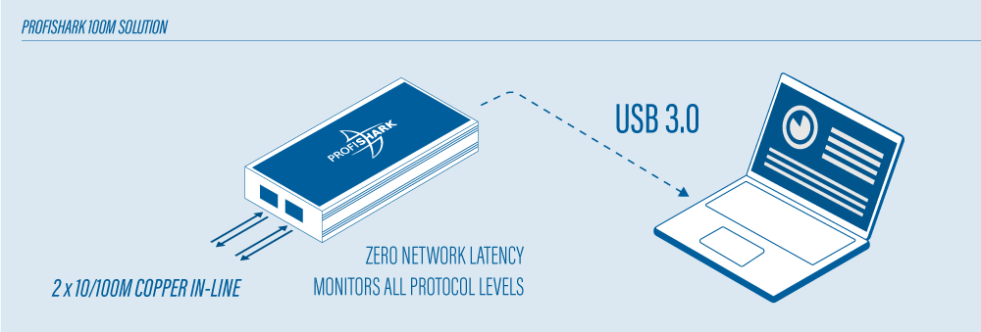
Inline tap

Slide 25
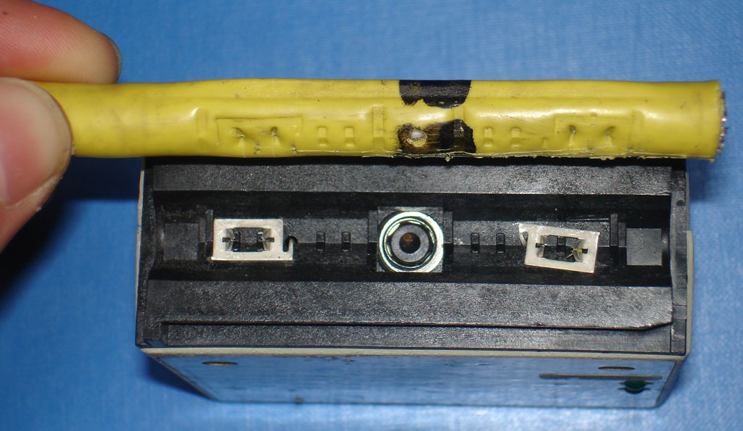
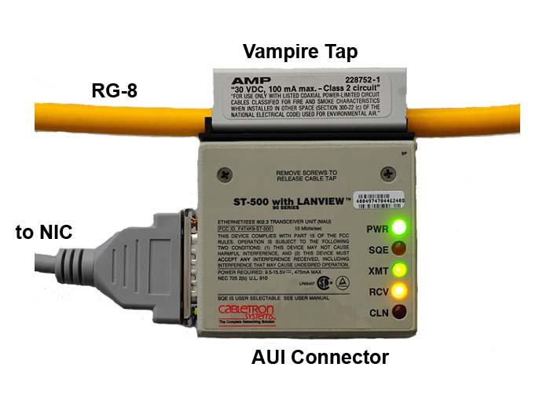
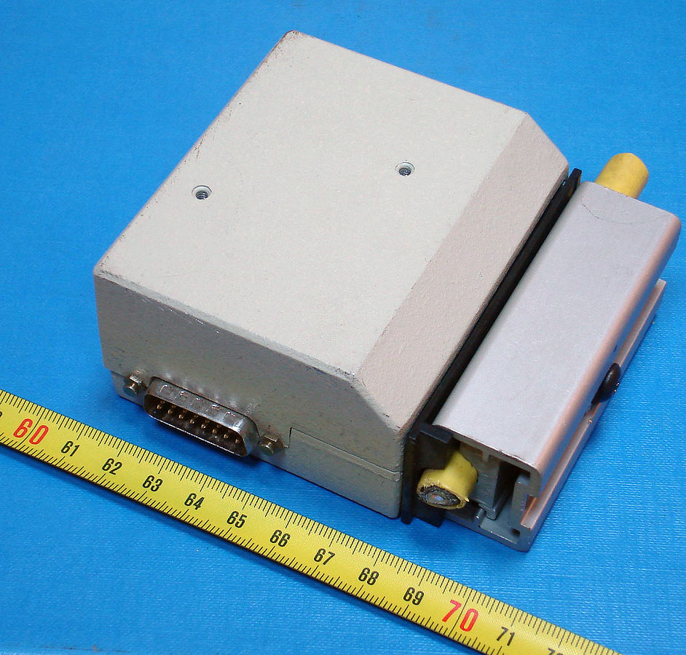
Vampire Taps
device for physically connecting a station, typically a computer, to a network that uses 10BASE5 cabling. This device clamps onto and "bites" into the cable

Slide 26
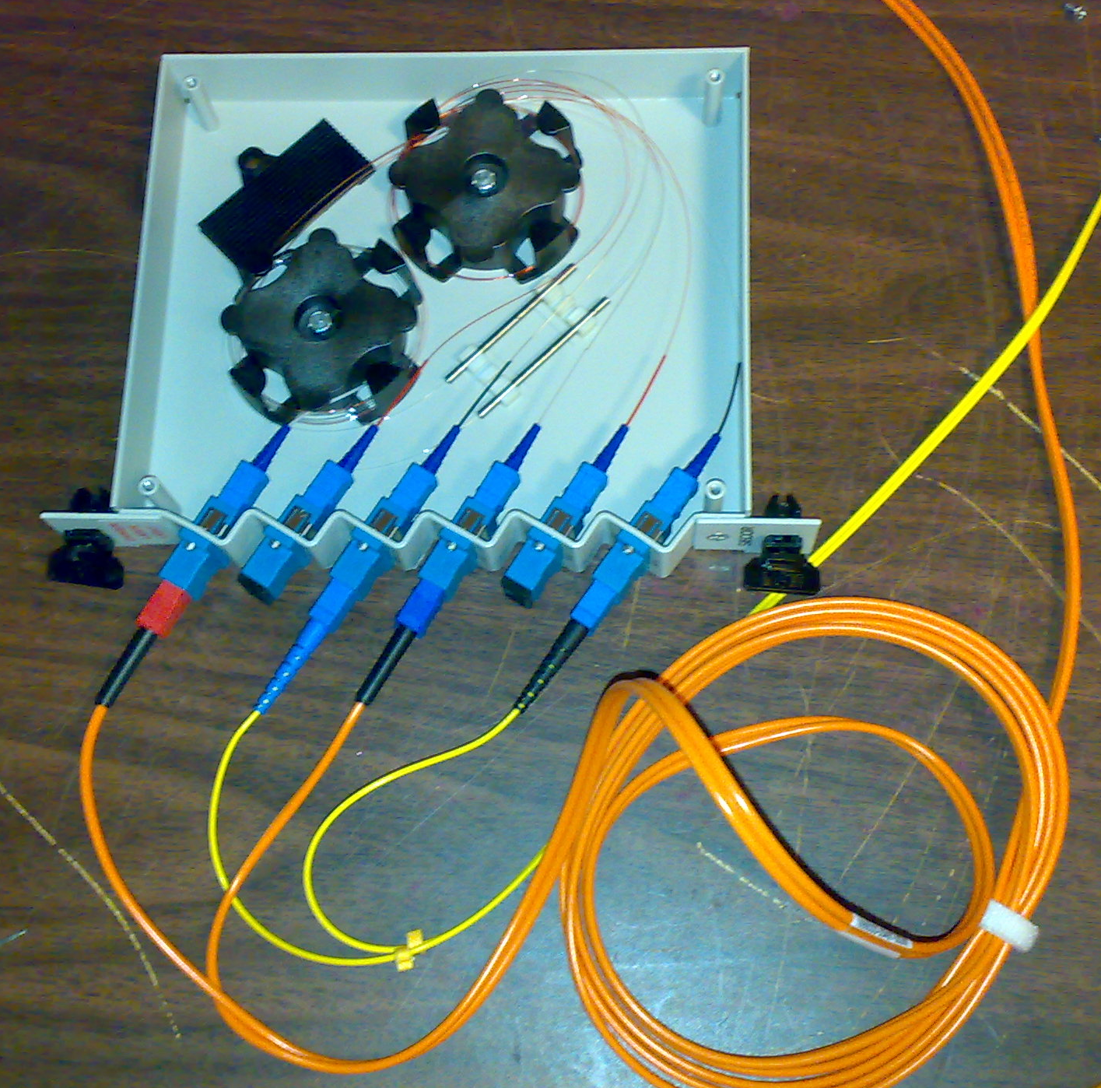
Fiber Optics
Fiber Bending
Attacker bends the fiber slightly.
Some light leaks out.
A sensor captures the leaked light.
Minimal signal loss if done carefully.

Slide 27
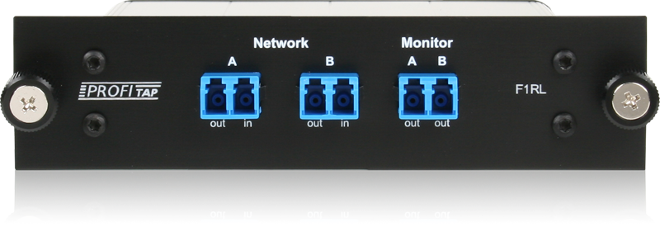
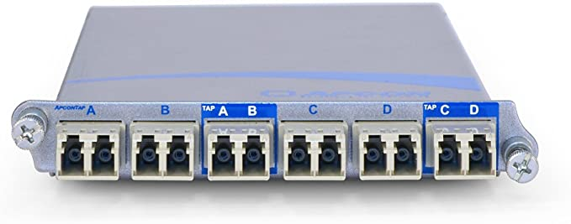
Fiber Optic Taps
To place a network tap inline on a fiber optic cable, network technicians splice the optic cable and connect it to each port of a tap. This causes a network disruption.
Inline optical taps may cause noticable signal degradation.
Network engineers often use tools called optical time-domain reflectometers (OTDR) to analyze and troubleshoot fiber optic cable signals

Slide 28
Radio Frequency
RF waves travel through the air, which is by nature a shared medium. As a result, WLAN traffic cannot be physically segmented in the way that switches segment traffic on a wired LAN.
This attribute makes passive acquisition of WLAN traffic very easy—both for investigators and attackers.
there are practical limitations on the distances over which stations can legally capture and receive data over 802.11 networks in the United States.
Even when the Wi-Fi traffic is encrypted, there is commonly a single pre-shared key (PSK) for all stations.
In this case, anyone who gains access to the encryption key can listen to all traffic relating to all stations (as with physical hubs)
Furthermore, there are well-known flaws in common 802.11 encryption algorithms such as Wired Equivalent Privacy (WEP), which can allow investigators to circumvent or crack unknown encryption keys.

Slide 29
Regardless of whether or not Wi-Fi traffic is encrypted, investigators can gain a great deal of information by capturing and analyzing 802.11 management traffic. This information commonly includes:
• Broadcast SSIDs (and sometimes even nonbroadcast ones)
• WAP MAC addresses
• Supported encryption/authentication algorithms
• Associated client MAC addresses
• In many cases, the full Layer 3+ packet contents
In order to capture wireless traffic, forensic investigators must first have the necessary hardware.
The network adapter must also support the specific 802.11 protocol in use (i.e., 802.11a/b/g cards do not necessarily support 802.11n).

Slide 30
Case 1: Hospital Laptop Goes Missing
A doctor reports that her laptop has been stolen from her office in a busy U.S. metropolitan hospital.
The computer is password-protected, but the hard drive is not encrypted.
Laptop may contain copies of some patient lab results, additional protected health information (PHI) downloaded from email attachments, schedules that include patient names, birth dates, and IDs, notes regarding patient visits, and diagnoses.

Slide 31
Potential Ramifications
Since the hospital is regulated by the United States’ Health Information Technology for Economic and Clinical Health (HITECH) Act and Health Insurance Portability and Accountability Act (HIPAA)
it would be required to notify individuals whose PHI was breached
If the breach is large enough, it would also be required to notify the media
This could cause significant damage to the hospital’s reputation, and also cause substantial financial loss, particularly if the hospital were held liable for any damages caused due to the breach

Slide 32
Important questions for the investigative team include:
1. Precisely when did the laptop go missing?
2. Can we track down the laptop and recover it?
3. Which patient data was on the laptop?
4. How many individuals’ data was affected?
5. Did the thief leverage the doctor’s credentials to gain any further access to the hospital network?

Slide 33
Technical Approach
When the laptop was stolen OR when the doctor last used it.
Establishing the time: gave the investigative team a starting point for searching physical surveillance footage and access logs
Network access logs
Investigators might also find evidence in wireless access point logs, Dynamic Host Control Protocol (DHCP) lease assignment logs, Active Directory events, web proxy logs
laptop tracking software (such as Lojack for Laptops)
Enterprise wireless access point (WAP) logs
If the laptop was still connected to the hospital’s wireless network
Email logs
More importantly, the hospital’s email server would have copies of all of the doctor’s emails, which would help investigators gather a list of patients likely to have been affected by the breach.
There might be authentication logs from Active Directory domain controllers, VPN concentrators, and other sources that indicate the laptop was used to access hospital resources even after the theft

Slide 34
Results
Leveraging wireless access point logs, the investigative team was able to pinpoint the time of the theft and track the laptop through the facility out to a visitor parking garage.
Parking garage cameras provided a low-fidelity image of the attacker.
The video was handed to the police, who were able to track the license plate.
The investigative team carefully reviewed VPN logs and operating system logs stored on the central logging server and found no evidence that the doctor’s laptop was used to attempt any further access to hospital IT resources

Slide 35
Catching a Corporate Pirate
GlobalCorp, Inc., has a centrally managed intrusion detection system, which receives alerts from sites around the world.
Central security staff notice an alert for peer-to-peer (P2P) filesharing, and on closer inspection see filename references to movies that are still in theaters.
Fearing legal ramifications of inaction, they investigate.
Potential Ramifications
If this activity were detected, the owner of the intellectual property might sue the company.

Slide 36
Questions
Important questions for the investigative team include:
1. Where is the source of the P2P traffic physically located?
2. Which user is initiating the P2P traffic?
3. Precisely what data is being shared?

Slide 37
Technical Approach
Using the IP address from the IDS alerts, investigators identified the physical site that was the source of the traffic.
intrusion analysts in the central office began capturing all of the P2P-related packets involving the IP address in question.
The local facility confirmed that this IP address was part of a local DHCP pool on the wired local area network
Intrusion analysts reviewed DHCP lease assignment logs for relevant time periods, and recovered the media access control (MAC) address associated with the suspicious activity. From the MAC address investigators identified the manufacturer of the network card.
In order to trace the IP address to a specific office, local networking staff logged into switches and gathered information mapping the IP address to a physical port of a email system administrator
Upon examination, however, it was clear that the confiscated desktop was the source of the P2P activity.
What if the confiscated desktop was not the source of the P2P activity?

Slide 38
Results
Network forensic analysts examined full packet captures grabbed by the IDS, and were ultimately able to carve out video files and reconstruct playable copyrighted movies that were still in theaters
Hard drive analysis of the correct desktop produced corroborating evidence that the movies in the packet capture had been resident on the hard drive.
The hard drive also contained usernames and email addresses linking the hard drive and associated network traffic with the suspect.

Slide 39
Hacked Government Server
During a routine antivirus scan, a government system administrator was alerted to suspicious files on a server.
The files appeared to be part of a well-known rootkit.
The server did not host any confidential data other than password hashes, but there were several other systems on the local subnet that contained Social Security numbers and financial information of thousands of state residents who had filed for unemployment assistance.
The administrative account usernames and passwords were the same for all servers on the local subnet.

Slide 40
Potential Ramifications
State laws required the government to notify any individuals whose Social Security numbers were breached.
If the servers containing this sensitive information were hacked, the state might be required to spend large amounts of money to send out notifications, set up hotlines for affected individuals, and engage in any resulting lawsuits.

Slide 41
Important questions for the investigative team include:
• Was the server in question truly compromised?
• If so, how was the system exploited?
• Were any other systems on the local network compromised?
• Was any confidential information exported?

Slide 42
Technical Approach
The server in question appeared to contain files with names that fit the pattern for a wellknown rootkit. -> Contains malicious software
Found in the home directory of an old local administrator account
local authentication logs had been deleted
investigators reviewed Secure Shell (SSH) logs from the central logging server that were associated with the account
Found brute-force password-guessing attack.
Investigators used visualization tools-> major spikes in the volume of authentication attempts
SSH logs showed location of attacker machine
As per network documentation perimeter firewall was supposed to be configured to block external access to the SSH port of servers

Slide 43
Technical Approach
Found active firewall configuration and found that it did not match the documented policy
Now probability is that the attacker may use credentials from that system to access other systems.
Fortunately, further analysis of the server hard drive indicated that the attacker’s access was short-lived; the antivirus scan had alerted on the suspicious files shortly after they were created.

Slide 44
Results
Investigators concluded that the server under investigation was compromised but that no other systems on the local subnet had been exploited and no personal confidential information had been breached.
To protect against future incidents, the state IT staff corrected the errors in the firewall configuration and implemented a policy in which firewall rules were audited at least twice per year
In addition, staff removed the old administrator account and established a policy of auditing all server accounts (including privileges and password strength) on a quarterly basis.

Slide 45
Traffic Acquisition Software
most common software libraries used for recording, parsing, and analyzing captured packet data: libpcap and WinPcap
tools based on these libraries, including tcpdump, Wireshark, snort and others

Slide 46
libpcap and WinPcap
Libpcap is a UNIX C library that provides an API for capturing and filtering data link layer frames from arbitrary network interfaces.
Different UNIX systems have different architectures for processing link-layer frames.
The purpose of libpcap was to provide a layer of abstraction so that programmers could design portable packet capture and analysis tools.
In 1999, the Computer Networks Group (NetGroup) in the Politecnico di Torino published WinPcap, a library based on libpcap that was designed for Windows systems.
The most popular packet sniffing and analysis tools today are based on the libpcap libraries. These include tcpdump, Wireshark, Snort, nmap, ngrep, and many others
A quintessential feature of libpcap-based utilities is that they can capture packets at Layer 2 from just about any network interface device and store them in a file for later analysis.

Slide 47
tcpdump
Tcpdump was designed as a UNIX tool
The basic purpose of tcpdump is to capture network traffic and then print or store the contents for analysis.
Tcpdump captures traffic bit-by-bit as it traverses any physical media suitable for conducting link-layer traffic
Beyond merely capturing packets, tcpdump can decode common Layer 2 through 4 Protocols
The decoded packets can be displayed in hexadecimal or in the ASCII equivalents (where the data is textual), or both.

Slide 48
Fidelity:
One reason that tcpdump is such a powerful tool is that it is capable of capturing traffic with high fidelity, to the degree that the resulting packet capture can constitute evidence admissible in court.
tcpdump’s ability to capture packets may be limited by the clock speed of the processor in the capturing workstation
on high-traffic networks, investigators may also be limited by disk space.
One crucial configuration option for capturing packets using tcpdump is the snapshot length, known as “snaplen.” Snaplen represents the number of bytes of each frame that tcpdump will record.
If the chosen snaplen is too short, data will be missing from every frame and can never be recovered. If the snaplen is too long, it may cause performance degradation, limit the volume of traffic that can be stored
Once upon a time, many people recommended using a snaplen of 1,514 bytes because the maximum transmission unit (MTU) of Ethernet is 1,500 bytes. Since the Ethernet header itself is 14 bytes long, this meant that the total frame length was 1,514 bytes.
Later versions of tcpdump allowed the user to specify “0” for the snaplen, which would tell tcpdump to automatically capture the entire frame, no matter how long it was. (backward compatibility)

Slide 49
Filtering Packets with tcpdump
One good strategy for analysis of large volumes of traffic is to begin by filtering out any types of traffic that are not related to the investigation.
Here’s an example that shows how tcpdump is used to display traffic from the “eth0” network interface, excluding TCP port 80 traffic:
# tcpdump -nni eth0 'not (tcp and port 80) ‘
• tcpdump -i eth0 -w great_big_packet_dump.pcap
This is the simplest case of listening on interface eth0 and writing all of the packets out to a single monolithic file.

Slide 50
tcpdump command-line usage:
-i Listen on interface (eth0 , en1 , 2)
-n Do not resolve addresses to names.
-r Read packets from a pcap file
-w Write packets to a pcap file
-s Change the snapshot length from the default
-C With -w, limit the capture file size , and begin a new file when it is
exceeded
-W With -C, limit the number of capture files created , and begin overwriting and rotating when necessary
-D List available adapters (WinDump only)

Slide 51
tcpdump -i eth0 -s 0 -w targeted_full_packet_dump.pcap 'host 10.10.10.10'
Here we introduce a simple BPF filter to grab and store in their entirety only those packets sent to or from the host at the address “10.10.10.10.”
tcpdump -i eth0 -s 0 -w RFC3514_evil_bits.pcap 'ip[6] & 0x80 != 0'
Finally, we introduce a more complicated BPF filter, in which we target the first byte of the IP fragmentation fields (byte offset 6). We employ a bitmask to narrow our inspection to the single highest order bit, most commonly known as the IP “reserved bit,” and we capture and store the packet only if the reserved bit is nonzero.
The Evil Bit (RFC 791): In original IP the very first, or “high order,” bit of the sixth byte offset would be “reserved
Bellovin suggested that any packet that had been built for malicious or evil intent must set this bit to one.
Later, Jason Mansfield has
created an “evil bit changer.” This handy utility captures traffic or reads it from a file, sets the Evil Bit to “1,” recalculates the IP header checksum, and then forwards the frame along to its intended destination

Slide 52
The Berkeley Packet Filter (BPF) Language
Libpcap includes an extremely powerful filtering language called the “Berkeley Packet Filter” (BPF) syntax.
BPF allows you to filter traffic based on value comparisons in fields for Layer 2, 3, and 4 protocols.
BPF invocations can be extremely simple, constructed from primitives such as “host” and “port” specifications, or very arcane constructions involving specific field values by offset (even down to individual bits).
BPF filters can also consist of elaborate conditional chains, nesting logical ANDs and ORs.

Slide 53
BPF Primitives
By far, the easiest way to construct a BPF filter is to use BPF primitives to refer to specific protocols, protocol elements, or qualities of a packet capture
The manual specifies three different kinds of qualifiers:
• type qualifiers say what kind of thing the id name or number refers to. Possible types are host, net, port and portrange.
• dir qualifiers specify a particular transfer direction to and/or from id. Possible directions are src, dst, src or dst, src and dst, addr1, addr2, addr3, and addr4.
• proto qualifiers restrict the match to a particular protocol. Possible protos are ether, fddi, tr, wlan, ip, ip6, arp, rarp, decnet, tcp and udp.

Slide 54
BPF Primitives
Commonly used BPF primitives include:
• host id, dst host id, src host id
• net id, dst net id, src net id
• ether host id, ether dst host id, ether src host id
• port id, dst port id, src port id
• gateway id, ip proto id, ether proto id
• tcp, udp, icmp, arp
• vlan id
There are many other BPF primitives.
Example: 'host 192.168.0.1 and not host 10.1.1.1 and (port 138 or port 139 or port 445) '

Slide 55
Filtering Packets by Byte Value
In addition to primitive comparisons, the BPF language can be used to compare the values of any byte-sized (or multibyte-sized) fields within a frame.
Important: Byte offsets are counted starting from 0!
Here are some examples: ip[9] != 1, icmp[0] = 3 and icmp[1] = 0, tcp[0:2] = 31337, ip[12:4] = 0xC0A80101
Filtering Packets by Bit Value
we cite a specific byte or bytes (as explained above), and then compare them bit-by-bit to some value that we hope to find. This is called “bitmasking.”
Let’s suppose that we’d like to filter for packets where IP options are set (in other words, the IP header length is greater than 20 bytes). The low-order nibble of the IP header represents the IP header length, measured in 32-bit “words” (each word is four bytes long).
To find all packets where the IP header is greater than 20 bytes in length, we need to match packets where the low-order nibble is greater than five (5 words ∗ 4 bytes per word = 20 bytes). To accomplish this, we create a BPF filter with a bitmask of “00001111” (0x0F), which is logically “AND-ed” with the targeted value. The resulting expression is: ip[0] & 0x0F > 0x05

